Slide 1
3D Reconstruction in CryoEM
Szu-Chi Chung
Institute of Statistical Science, Academia Sinica

Slide 2
Outline
Introduction
Principles
Projection-Slice Theorem
Weak phase object approximation
Ab initial model generation
3D Refinement
Conclusion

Slide 3
Introduction

Slide 4
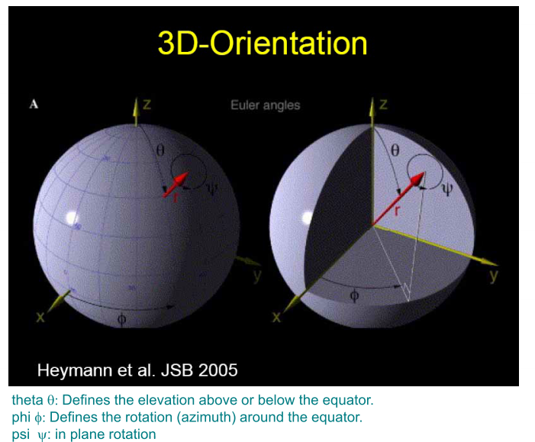
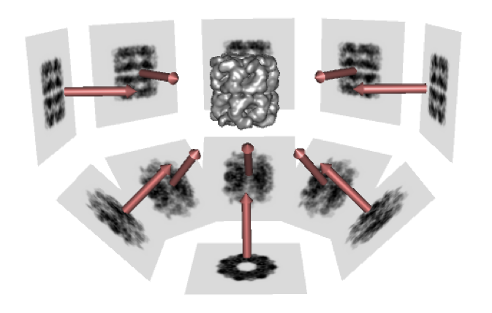
Introduction
Based on 3DEM Conventions

Slide 5
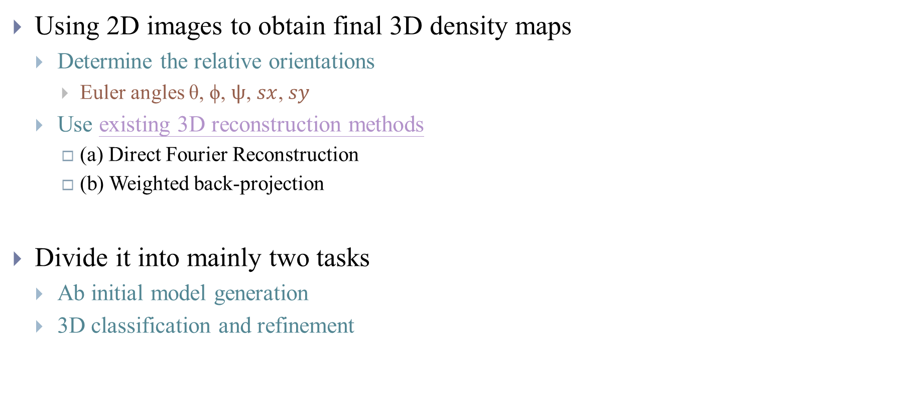
Introduction
Using 2D images to obtain final 3D density maps
Determine the relative orientations
Euler angles θ, ϕ, $ψ$, $sx$, $sy$
Use existing 3D reconstruction methods
(a) Direct Fourier Reconstruction
(b) Weighted back-projection
Divide it into mainly two tasks
Ab initial model generation
3D classification and refinement

Slide 6
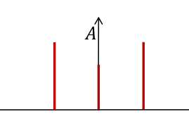
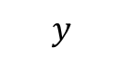
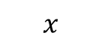
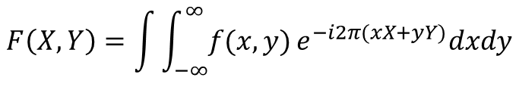
Introduction
2D Fourier transform
$$y$$
Intensity vs frequency
Result is complex number
2D Shift
$$x$$
$$F\left(X,Y\right)=\int{\int_{−∞}^{∞}{f(x,y)}e^{−i2π(xX+yY)}dxdy}$$
Notes:
1. Symmetric around original points!
2. Reference also see https://www.youtube.com/watch?v=nyk75ufbP74&t=0s&index=18&list=PL8_xPU5epJdctoHdQjpfHmd_z9WvGxK8-

Slide 7
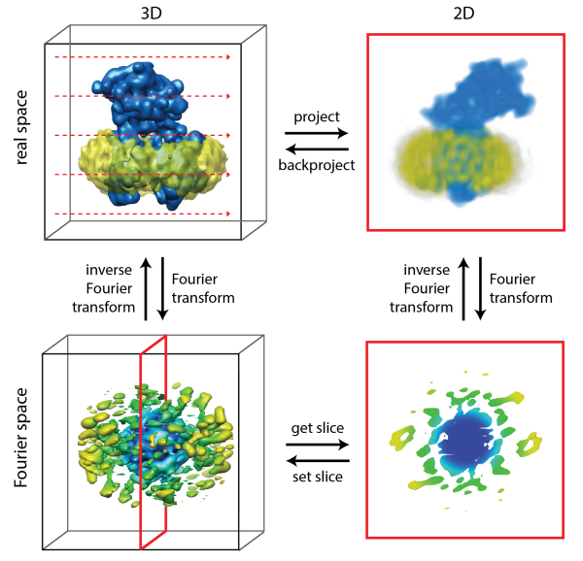
Core - Projection-Slice Theorem
Notes:
Fourier space following is easy:
Convolution, filter, Cross correlation
Linear model

Slide 8
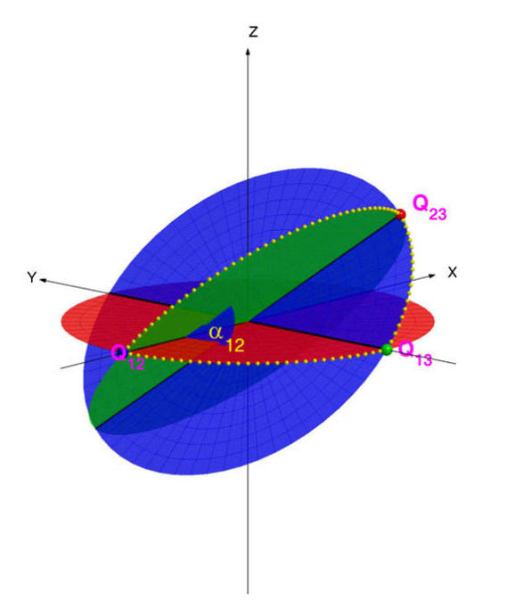
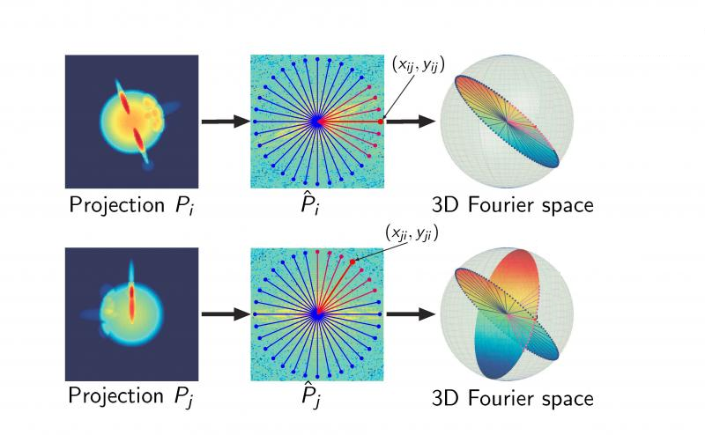
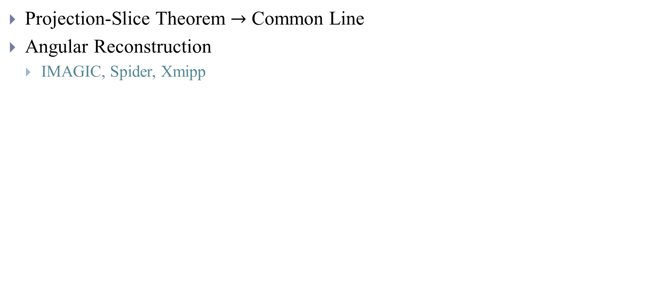
Initial Model - Pure computational methods
Projection-Slice Theorem $→$ Common Line
Angular Reconstruction
IMAGIC, Spider, Xmipp
Notes:
Only obtain initial model, since it can not iterative refine (when SNR is low do single run will not be accurate)

Slide 9
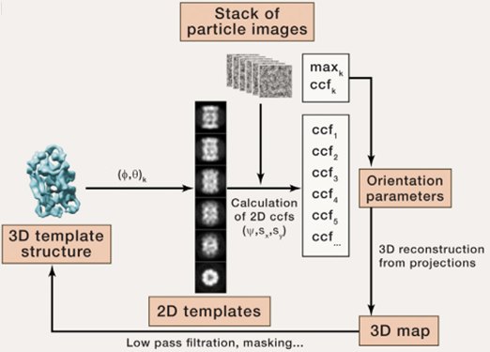
Initial Model - Pure computational methods
Projection Matching
Randomized orientation parameters (or a 3D distribution of random noise as the template)
EMAN2, Frealign
Stochastic Hill Climbing
PRIME
VIPER
Maximum likelihood
Stochastic gradient descent
ad hoc regularisation
Notes:
1. Stochastic Hill Climbing:
The templates are scanned in a random order and the first one with a similarity score better than the one obtained at a previous iteration is accepted
Instead of finding the best possible match between an EM projection image and all reprojection templates
the procedure will initially accept orientations that are entirely incorrect and only slowly drift towards increasingly sensible orientations
2. If not add low pass filter -> overfitting noise (noisy structure)
Always want to see high resolution

Slide 10
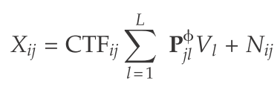
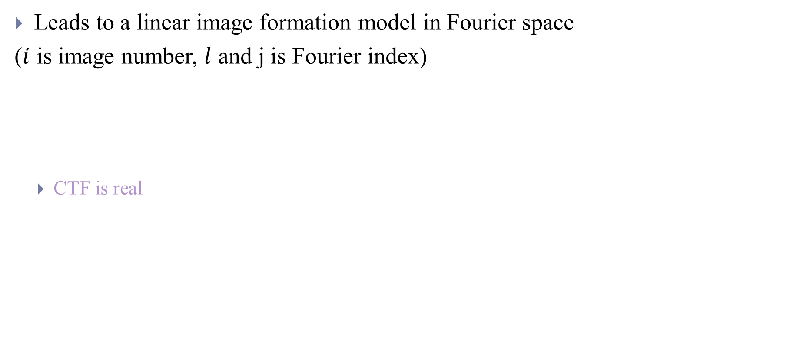
Core - weak phase object approximation
Leads to a linear image formation model in Fourier space
($i$ is image number, $l$ and j is Fourier index)
CTF is real
3D structure
2D particle image
Independent, Gaussian distributed noise
Projection/Slice Operator
Notes:
1. Speciman thin enough
2. if the point spread function is symmetric around its center

Slide 11
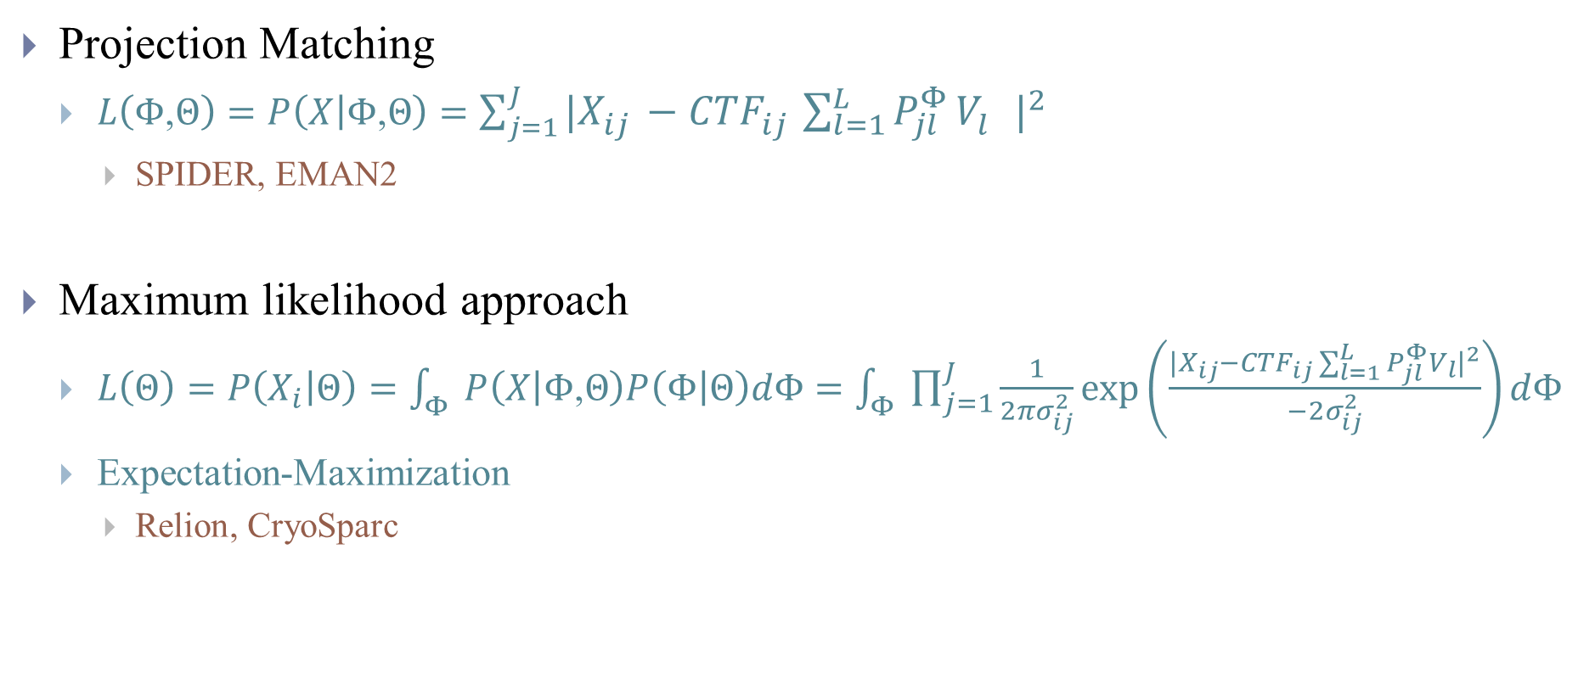
3D Refinement and Classification
Projection Matching
$L\left(Φ\text{,}Θ\right)=P\left(X | Φ\text{,}Θ\right)=\sum_{j=1}^{J}{{|X_{ij}^{}−{CTF}_{ij}^{}\sum_{l=1}^{L}{P_{jl}^{Φ}}V_{l}^{}|}^{2}}$
SPIDER, EMAN2
Maximum likelihood approach
$L\left(Θ\right)=P\left(X_{i} | Θ\right)=\int_{Φ}{P\left(X | Φ\text{,}Θ\right)P\left(Φ | Θ\right)dΦ}=\int_{Φ}{\prod_{j=1}^{J}{\frac{1}{2πσ_{ij}^{2}}\exp\left(\frac{|{X_{ij}−{CTF}_{ij}\sum_{l=1}^{L}{P_{jl}^{Φ}V_{l}}|}^{2}}{−2σ_{ij}^{2}}\right)dΦ}}$
Expectation-Maximization
Relion, CryoSparc
Model
Orientations
They are equivalent if there is no noise!
Notes:
When there is no noise weight of MLE is 1 only at the lowest MSE orientation which is exactly the same as projection matching

Slide 12
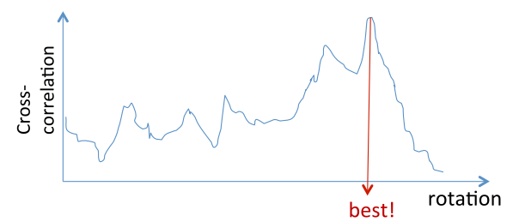
3D Refinement and Classification
Maximum likelihood results in weighted average structure

Slide 13
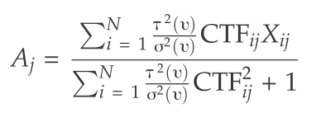
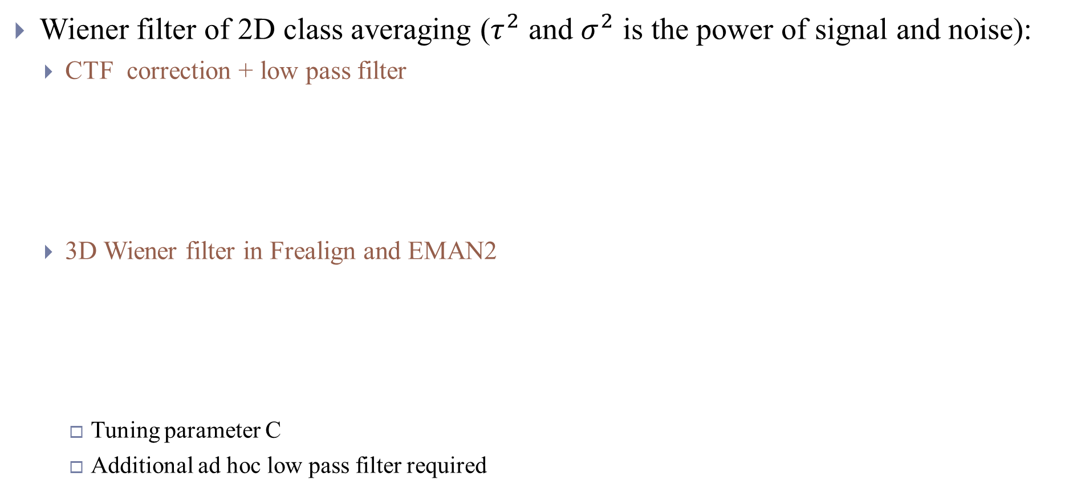
Before Relion - Wiener filter
Wiener filter of 2D class averaging ($τ^{2}$ and $σ^{2}$ is the power of signal and noise):
CTF correction + low pass filter
3D Wiener filter in Frealign and EMAN2
Tuning parameter C
Additional ad hoc low pass filter required

Slide 14
Relion

Slide 15
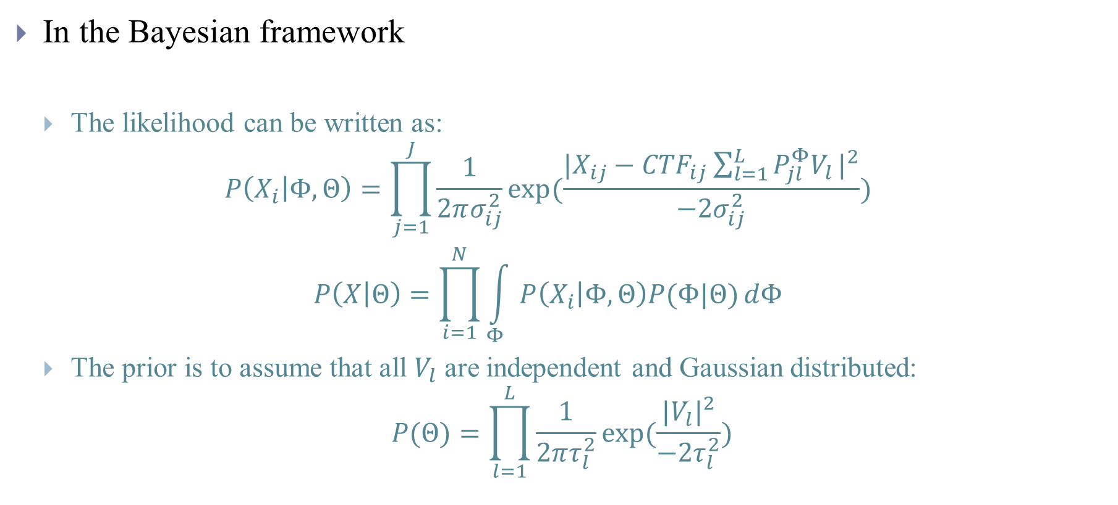
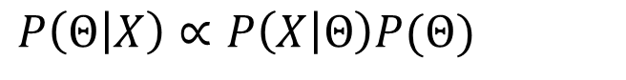
REgularised LIkelihood OptimisatioN (Relion) (2012)
In the Bayesian framework
The likelihood can be written as:
$$P\left(X_{i} | Φ,Θ\right)=\prod_{j=1}^{J}{\frac{1}{2πσ_{ij}^{2}}exp⁡(\frac{|{X_{ij}−{CTF}_{ij}\sum_{l=1}^{L}{P_{jl}^{Φ}V_{l}}|}^{2}}{−2σ_{ij}^{2}})}$$
$$P\left(X | Θ\right)=\prod_{i=1}^{N}{\int_{Φ}{P\left(X_{i} | Φ,Θ\right)P(Φ|Θ)}dΦ}$$
The prior is to assume that all $V_{l}$ are independent and Gaussian distributed:
$$P(Θ)=\prod_{l=1}^{L}{\frac{1}{2πτ_{l}^{2}}exp⁡(\frac{|{V_{l}|}^{2}}{−2τ_{l}^{2}})}$$
$P\left(Θ | X\right)∝P\left(X | Θ\right)P(Θ)$
Prior information about the orientations
Notes:
https://stats.stackexchange.com/questions/163388/l2-regularization-is-equivalent-to-gaussian-prior

Slide 16
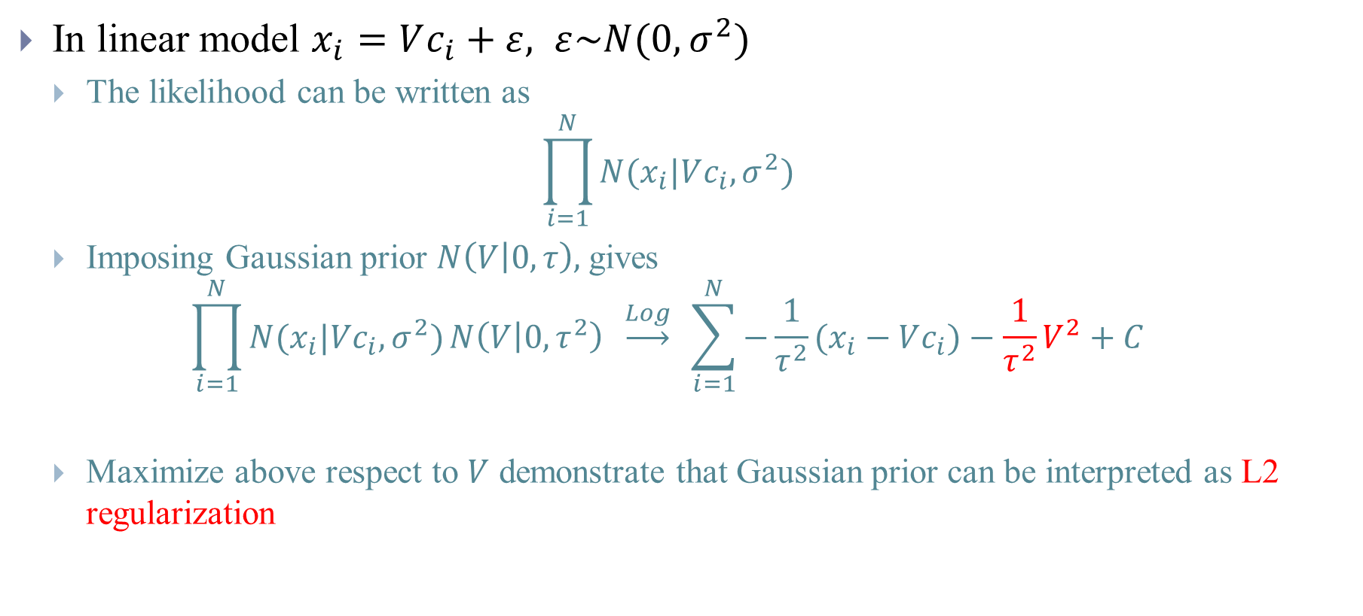
(1) Model
In linear model $x_{i}=Vc_{i}+ε, ε\sim N(0,σ^{2})$
The likelihood can be written as
$$\prod_{i=1}^{N}{N(x_{i}|Vc_{i},σ^{2})}$$
Imposing Gaussian prior $N\left(V | 0,τ\right),$ gives
$$\prod_{i=1}^{N}{N(x_{i}|Vc_{i},σ^{2})}N\left(V | 0,τ^{2}\right) \underset{→}{Log} \sum_{i=1}^{N}{−\frac{1}{τ^{2}}(x_{i}−Vc_{i})}−\frac{1}{τ^{2}}V^{2}+C$$
Maximize above respect to $V$ demonstrate that Gaussian prior can be interpreted as L2 regularization

Slide 17
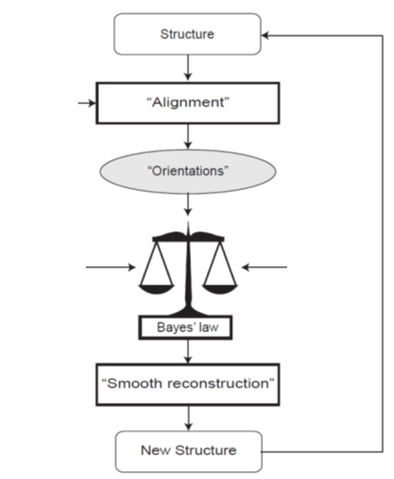
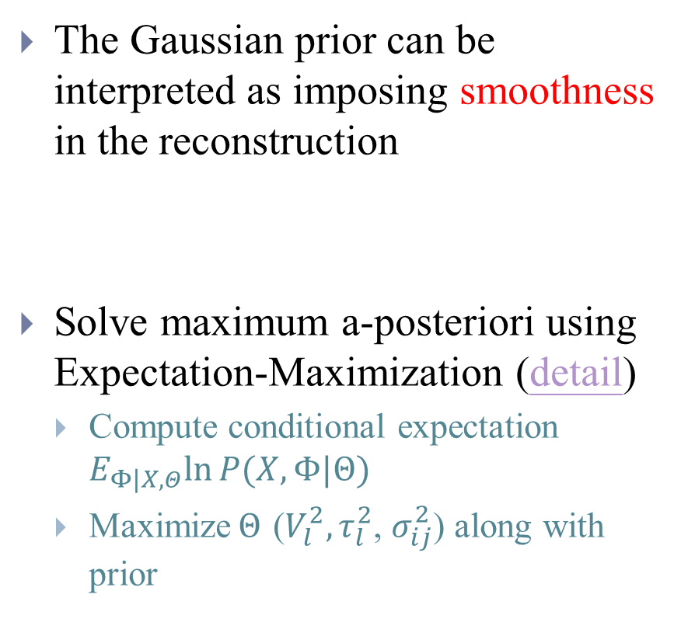
(1) Model
The Gaussian prior can be interpreted as imposing smoothness in the reconstruction
Solve maximum a-posteriori using Expectation-Maximization (detail)
Compute conditional expectation $E_{Φ|X,Θ}ln⁡P(X,Φ|Θ)$
Maximize$Θ$ ($V_{l}^{2}, τ_{l}^{2}$, $σ_{ij}^{2}$) along with prior
Experiment Data
Smooth Prior
Iterate
Notes:
Actually dependent so that $τ_{l}^{2}$ should increase

Slide 18
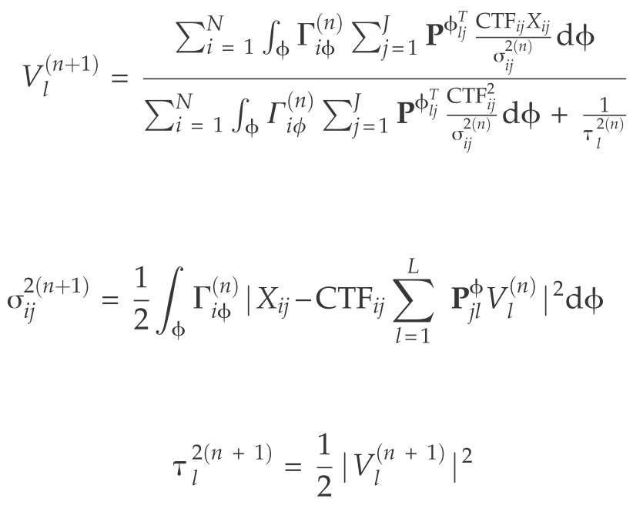
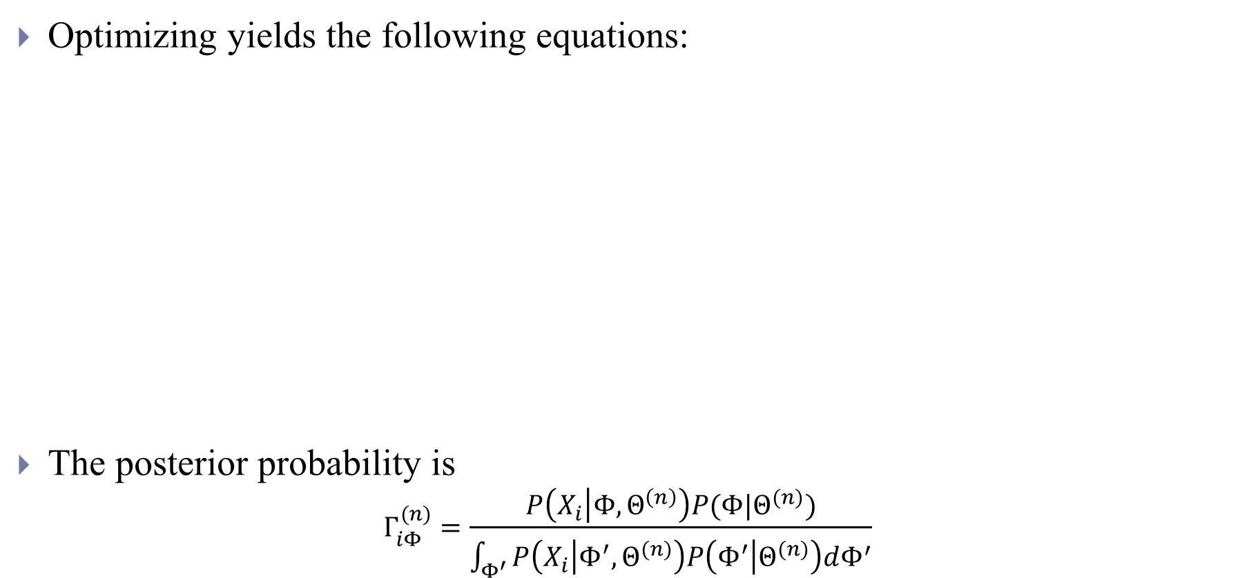
(1) Model
Optimizing yields the following equations:
The posterior probability is
$$Γ_{iΦ}^{(n)}=\frac{P\left(X_{i} | Φ,Θ^{\left(n\right)}\right)P(Φ|Θ^{(n)})}{\int_{Φ^{′}}{P\left(X_{i} | Φ^{′},Θ^{(n)}\right)P\left(Φ^{′} | Θ^{(n)}\right)dΦ^{′}}}$$
Backprojection
It will be over-smooth in practice, thus will be multiply by T=2~4
Integration are performed within 3 times the standard deviation (Truncated Gaussian are used)
Notes:
1. Local orientation search
Mean are set to the optimal of previous iterations
2. Numerical quadrature is used to calculate marginalization

Slide 19
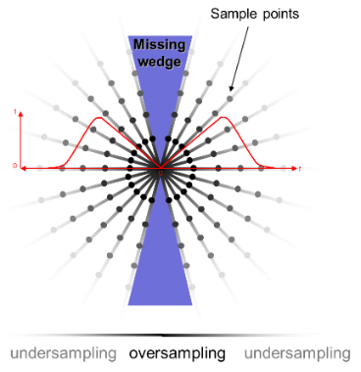
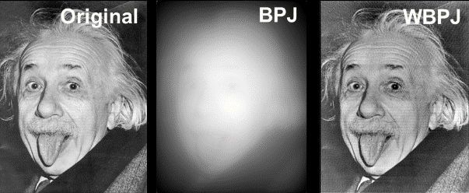
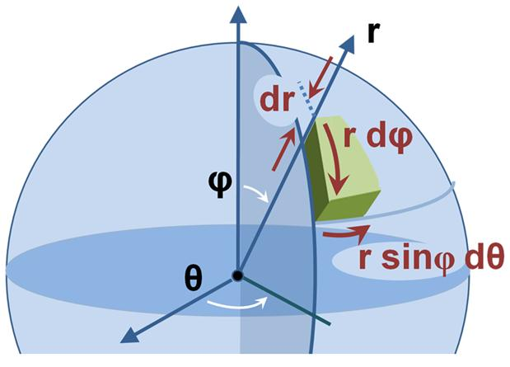
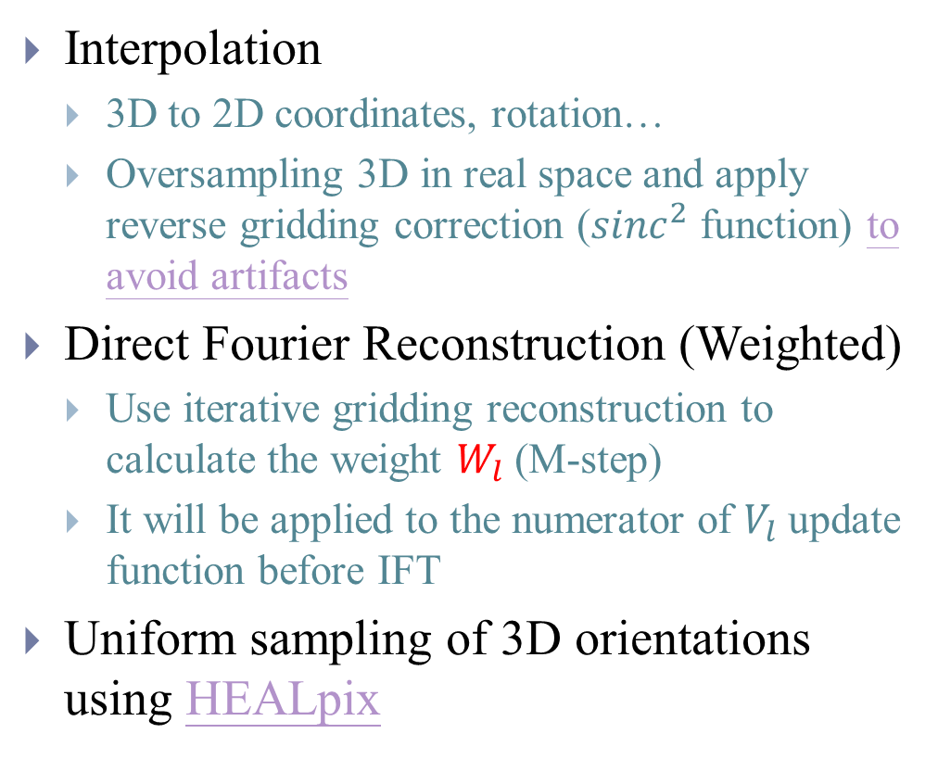
(2) Implementation
Interpolation
3D to 2D coordinates, rotation…
Oversampling 3D in real space and apply reverse gridding correction (${sinc}^{2}$ function) to avoid artifacts
Direct Fourier Reconstruction (Weighted)
Use iterative gridding reconstruction to calculate the weight $W_{l}$ (M-step)
It will be applied to the numerator of $V_{l}$ update function before IFT
Uniform sampling of 3D orientations using HEALpix
Notes:
1. Interpolation is required for any operation that requires a pixel value at a non-integer coordinate
2. Surface area: https://en.wikipedia.org/wiki/Volume_element

Slide 20
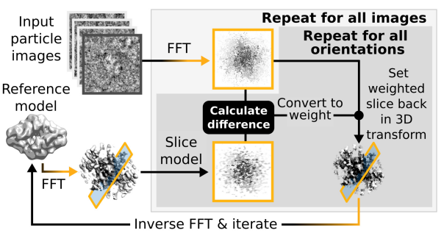
(2) Implementation
Computation complexity
(iv)
(ii)
(i)
(iii)
Notes:
1. E-step contains 4 major steps (Single Precision) calculate in GPU
(i),(ii) is performed twice for every particles (Coarse-> Fine)
(iii) is cheap, while (iv) is expensive
2. M-step require large amount of memory (Double Precision) in CPU
Experiment decide M step to be in CPU
Backprojection (E-step)

Slide 21
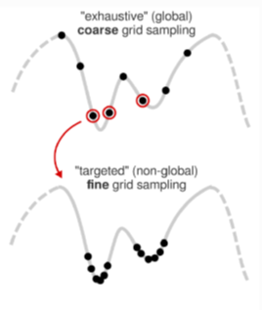
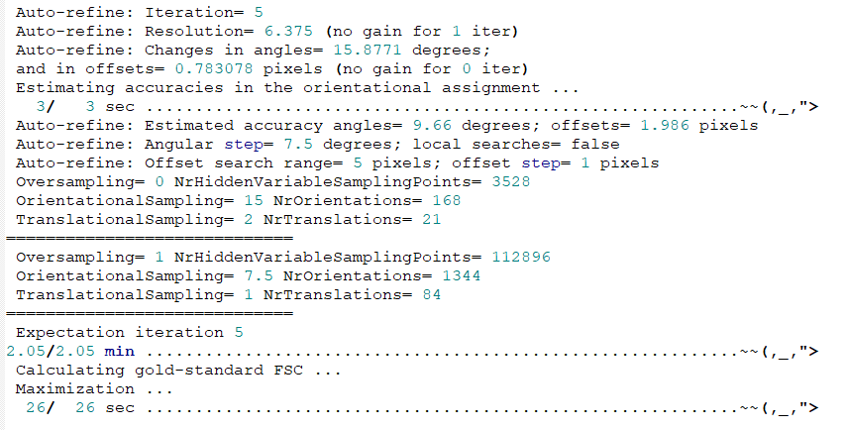
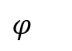
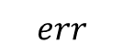
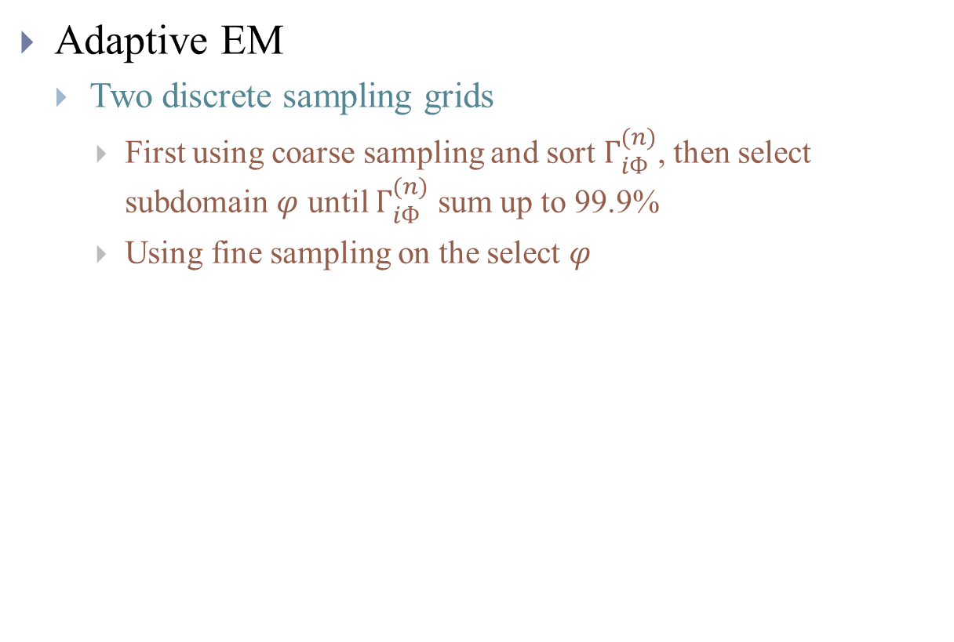
(2) Implementation
Adaptive EM
Two discrete sampling grids
First using coarse sampling and sort $Г_{iФ}^{(n)}$, then select subdomain $φ$ until $Г_{iФ}^{(n)}$ sum up to 99.9%
Using fine sampling on the select $φ$
$$err$$
$φ$
Notes:
In practice, $Г_{iФ}^{(n)}$ is close to zero for many $φ$

Slide 22
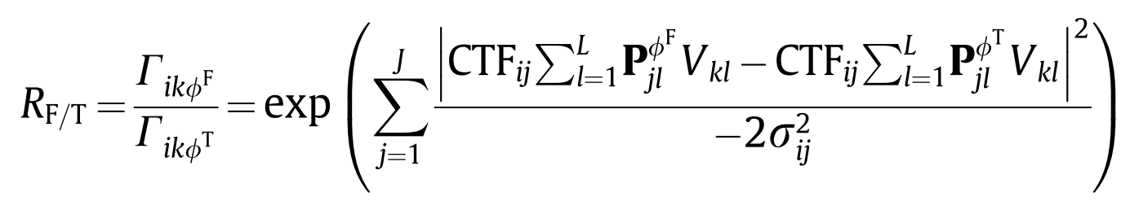
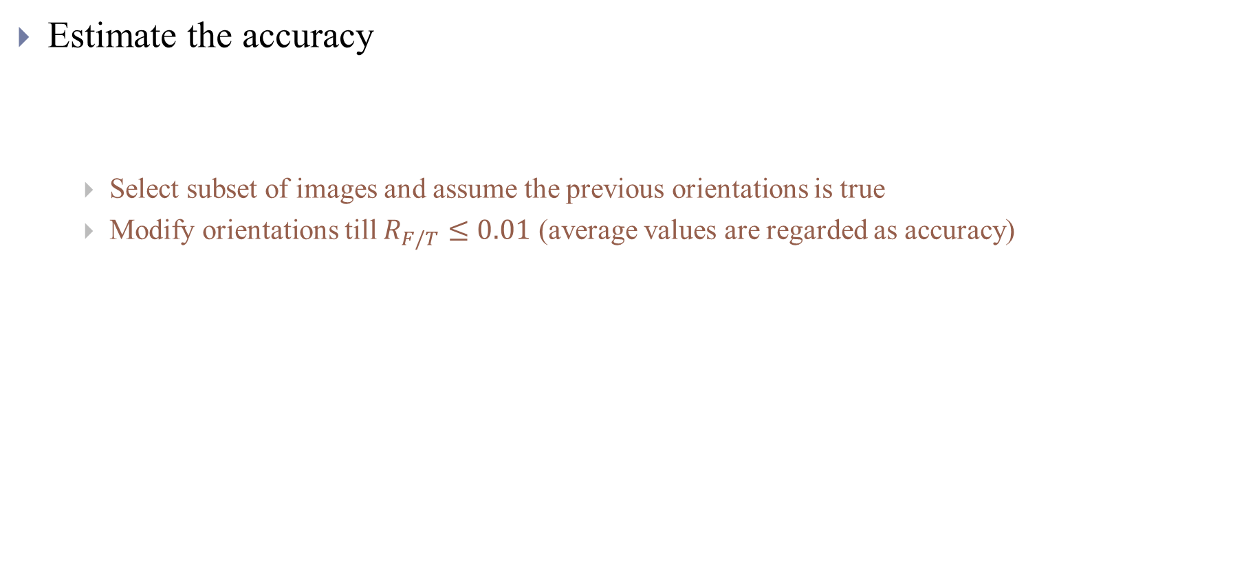
(2) Implementation
Estimate the accuracy
Select subset of images and assume the previous orientations is true
Modify orientations till $R_{F/T}≤0.01$ (average values are regarded as accuracy)
Posterior prob. of true orientations

Slide 23
(2) Implementation
Stopping Criterion:
Estimated resolution is not improve or orientations does not change
2-fold angular sampling rate
Translation sampling adjust according to estimated accuracy
Iterates until angular sampling rate is finer than estimated accuracy
Experiment Data
Smooth Prior
Iterate
Notes:
Tuning parameters
Mask diameter (or user defined mask)
Initial low pass filter (40A~60A)
Initial angular sampling (7.5)
Local search start from (1.8)
Initial offset range (6)
Initial offset step (1)

Slide 24
CryoSparc

Slide 25
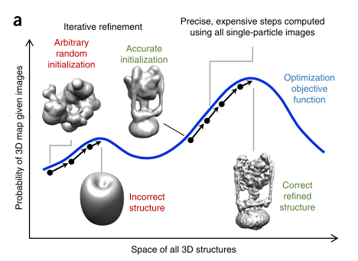
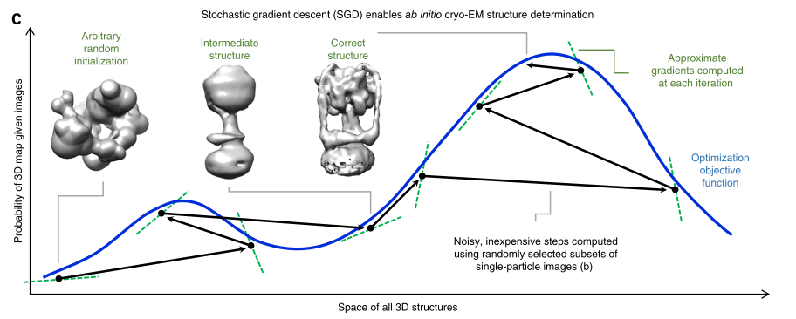
CryoSparc (2017)
Disadvantages of Relion
Sensitive to initialization
Computation is slow

Slide 26
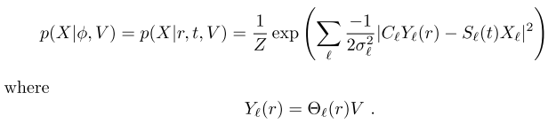
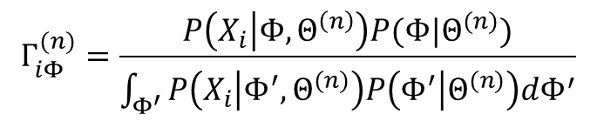

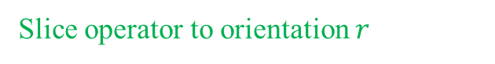
CryoSparc (2017)
RELION uses orientation marginalization and a batch Expectation-Maximization algorithm
Use of a similar marginalized likelihood
Stochastic optimization for both efficiency and robustness to initialization
Introduce a novel branch and bound technique
Reduces the computational cost of the marginalization
Risk-free method
2D translation of $t$ pixels
Slice operator to orientation $r$
Search region
$$Γ_{iΦ}^{(n)}=\frac{P\left(X_{i} | Φ,Θ^{\left(n\right)}\right)P(Φ|Θ^{(n)})}{\int_{Φ^{′}}{P\left(X_{i} | Φ^{′},Θ^{(n)}\right)P\left(Φ^{′} | Θ^{(n)}\right)dΦ^{′}}}$$
Notes:
No assumption that all 3D classes are similar to the single reference

Slide 27
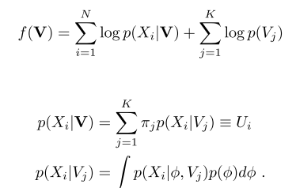
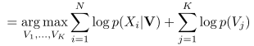
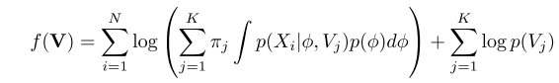
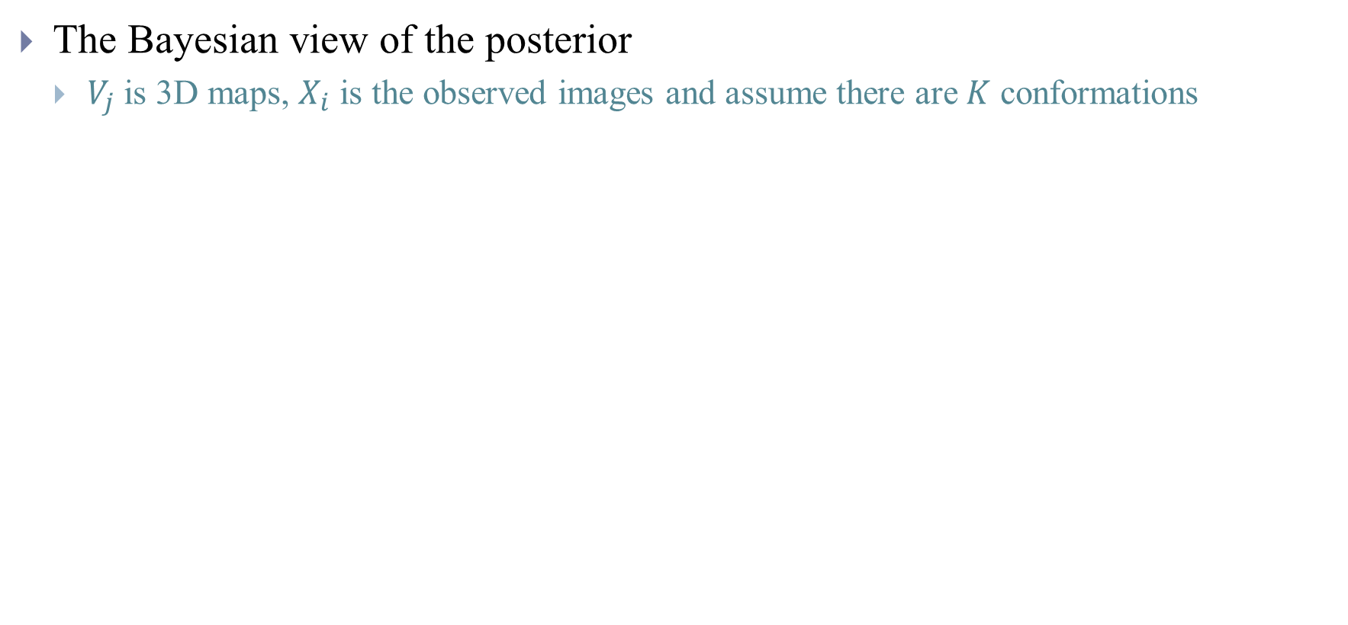
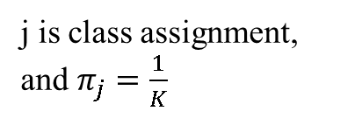
CryoSparc (2017) – Ab initial
The Bayesian view of the posterior
$V_{j}$ is 3D maps, $X_{i}$ is the observed images and assume there are $K$ conformations
j is class assignment, and $π_{j}=\frac{1}{K}$
Uniform
Notes:
Uniform prior of orientations is used in ab initial model generation

Slide 28
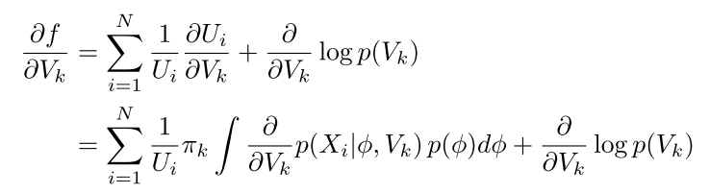
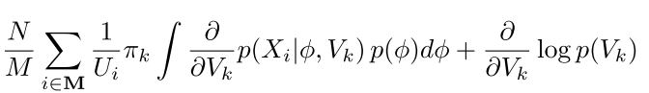
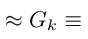

(1) Stochastic Gradient Descent (SGD)
The gradient is approximate by a mini-batch $M$
Mini-batch size auto adjust $30×K → 100×K$(when resolution exceeds 20A)

Slide 29



(1) SGD
SGD update with momentum and step size
0.9
Current Gradient
Step Size (Different for each $V_{k}$)
Notes:
# now, logZ_ik is the full normalizer across k,r,s for each image, but duplicated across k
ess_r = (1.0 / n.sum( n.sum(self.prob_cpu[:,:,:self.N_RS,:], axis=3)**2, axis=-1))
ess_s = (1.0 / n.sum( n.sum(self.prob_cpu[:,:,:self.N_RS,:], axis=2)**2, axis=-1))
ess_C = 1.0 / n.sum(self.class_posterior_ik**2, axis=1)
class_posterior_ik = n.exp(self.logZ_ik_cpu_preanneal - self.logZ_ik_cpu)
# error_gpu is the negative log prob unnormalized
# for a given i,k: [where prob is error_gpu_ik[r,s] normalized over r,s]
# ess_R = 1 / sum_r( (sum_s prob) ** 2 )
# ess_S = 1 / sum_s( (sum_r prob) ** 2 )
# the normalizers are self.logZ_ik_cpu_preanneal, i.e.
# log prob_ik[r,s] = -error_gpu_ik[r,s] - logZ_ik
# so in log space # log ess_R = - log sum_s exp ( 2 * log sum_s exp log prob ) # log ess_S = - log sum_r exp ( 2 * log sum_r exp log prob )

Slide 30









(1) SGD
Step size are set using the approximation of second order curvature of $f$, which is known as Hessian
$$|x_{0}+\frac{b}{2a}|$$
$$\frac{|2ax_{0}+b| }{2a}$$
$$\frac{∂^{2}y}{∂x^{2}}=2a$$
$$−\frac{b}{2a}$$
$$x_{0}$$
$$y=ax^{2}+bx+c$$
|First derivative|
best step is
Second derivative
Notes:
1. In practice: 0.4 -> 0.2 -> 0.1
2. This is actually close to Adam optimizer which is
(Adagrad->RMSProp) + Momentum

Slide 31

CryoSparc (2017) – Ab initial
For $i <$ $iterations_numbers$
Apply premult and go to Fourier space
Compute gradient in Fourier space
Move gradient back to Real space and apply premult again
Compute step direction and take step on Real space density
Remarks
Initial the model by selecting 10 images (assigning random orientations) to construct the random initial 3D real space
Adjust noise model, learning rate, batch size, resolution under consideration during iterations
Notes:
# Procedure for EM:
# done
Do E step on premulted fspace density
Apply nn constraint
# Procedure for gradient:
# start with correct realspace density
# apply premult and go to fourier space
# do E step on premulted fspace density
# do gradient using premulted fspace and alignments
# move gradient back to real space and apply premult again
# compute step direction
# take step on real space density
# apply nn constraint
# apply

Slide 32
CryoSparc (2017) – 3D Refine
Once the SGD converge (to 10~12 A), the Expectation-Maximization algorithm is used to refine
Branch and Bound Optimization
Branch-and-bound optimization formalized the local orientation search problem
Significantly faster than previous heuristic methods
Risk free of missing the optimal alignment
Trying to find the exact pose so that we can avoid marginalization

Slide 33


(2) Branch and Bound
It is a global pose search and no prior estimate of optimal pose are require
The bound is based on high-resolution features in an image contribute less to alignment than low-resolution features
Notes:
1. The bound should be easy to compute and close to actual one, thus use low resolution to approximate actual one
2. The bound is base on the SNR of single particle images over a range of resolutions
Some heuristic methods has also exploit this feature: first provide a guess for the optimal pose of each image and use local search for high resolution
Some heuristic methods has also exploit this feature: first provide a guess for the optimal pose of each image and use local search for high resolution
Still computationally expensive
Require extra tunable parameters for when to start and how much to restrict local search
Run the risk of missing the optimal alignment

Slide 34


(2) Branch and Bound
All 2d frequencies
Considering single image and structure
Taking the negative log, we get the image alignment error
Gradually increase with iterations (initial 12 and double each iteration)
Notes:
The bound is resolution and SNR dependent

Slide 35



(2) Branch and Bound
Bound B below with (details can be found here)
Independent of orientations
Correlation between the slice and the noise which is Gaussian distribution
Notes:
Make the expression free from orientation parameters r, so that we only have to calculate it once!

Slide 36





(2) Branch and Bound
Bound $B$ below with (Noise and resolution dependent bound)
Only computed once for all $r,t$
Slice that has maximum CTF modulated total power

Slide 37

(2) Branch and Bound
Seven iterations of branch and bound are conducted
In each iterations the sampling points are double in the grid
The spacing is set too 24 degrees and 5 pixels empirically
Initially, $L=12$ and double in each iteration
To avoid the non-particle image that gives poor alignment in many orientations
The region is set to 12.5% for 3-D orientations and 25% for 2-D shift after each iteration of search
Notes:
Use Axis-angle representation for 3D-pose

Slide 38

CryoSparc (2017) – 3D Refine
For $i <$ $iterations_numbers$
Apply premult and go to Fourier space
Branch and bound to find best orientations (Find best orientations)
Solve structure in Fourier space (EM formula same as Relion)
Move back to Real space and apply premult again
Remarks
Start with reference map
Adjust noise model, batch size, considered resolution, branch and bound region during iterations
Split the training set into two set for FSC calculation

Slide 39
Conclusion

Slide 40
Conclusion
3D reconstruction is an active research area
Robust initial model generation
Reducing computational costs
3D classification (Discrete heterogeneity)
Continuous heterogeneity
….
The trend is to develop
Objective, automated approaches that can produce reliable information
Free from the subjectivity of the human

Slide 41
Reference
Scheres, S. H. W. A Bayesian view on cryo-EM structure determination. Journal of Structural Biology, 2012, Volume 415, Pages 406-418
Sjors H.W. Scheres. RELION: Implementation of a Bayesian approach to cryo-EM structure determination, Journal of Structural Biology, 2012, Volume 180, Issue 3,Pages 519-530
Kimanius, Dari, et al. Accelerated cryo-EM structure determination with parallelisation using GPUs in RELION-2. 2016, Elife 5
Punjani, A.; Brubaker, M. A. & Fleet, D. J. Building Proteins in a Day: Efficient 3D Molecular Structure Estimation with Electron Cryomicroscopy. IEEE transactions on pattern analysis and machine intelligence, 2017, Volume 39, Pages 706-718
Punjani, A.; Rubinstein, J. L.; Fleet, D. J. & Brubaker, M. A. cryoSPARC: algorithms for rapid unsupervised cryo-EM structure determination. Nature methods, 2017
2D implementation of Relion and CryoSparc https://github.com/Arunabh98/EPFL-CryoEM

Slide 42
Appendix

Slide 43









CryoSparc – Noise Model
Noise in image formation model also account for model error (for ab initial reconstruction) which will gradually reduce (at frequency $l$ and iteration $k$)
Average reconstruction error
Decay rate
Ensure objective function is relatively smooth, this is to inflated the model in the initial
Initial prior weight
Initial white noise estimate from particle corner
Notes:
if compute_phis:
# this will save the best alignment directly
bestri, bestti = n.unravel_index(V.argmin(), V.shape)
img.alignments[key].r = img_rs.reshape(-1,3)[bestri]
img.alignments[key].t = img_ts.reshape(-1,2)[bestti]
img.alignments[key].U = V[bestri, bestti]

